Slide 1




Linux System Programming & Kernel Interface

Slide 2




TABLE OF CONTENT
01
02
TRAINING PREVIEW
Intro to Linux System Programming
03
04
Linux System Programming
Advanced Linux System Programming & Kernel Interface
BACK
NEXT

Slide 3


Training Preview
The Training takes about 7 Months of totally 37 sessions, 185 training hours and 2 projects.
It started at 01/2024 and ended just before 09/2024.
It was taken at STMicroelectronics company Egypt branch.
BACK
NEXT

Slide 4
What is STM?
STMicroelectronics is a major European multinational semiconductor company that was established in 1987 following the merger of two state-owned entities: SGS Microelettronica of Italy and Thomson Semiconducteurs of France. Initially named SGS-THOMSON, the company adopted the name STMicroelectronics in 1998. Headquartered in Plan-les-Ouates, Switzerland, ST is the largest semiconductor company in Europe and one of the top players globally.
STMicroelectronics designs, manufactures, and markets a wide array of semiconductor products, including microcontrollers, power management chips, sensors, and integrated circuits. The company is heavily involved in automotive, industrial, consumer electronics, and communication technologies, and has a strong presence in emerging fields like silicon carbide for electric vehicles.
BACK
NEXT

Slide 5
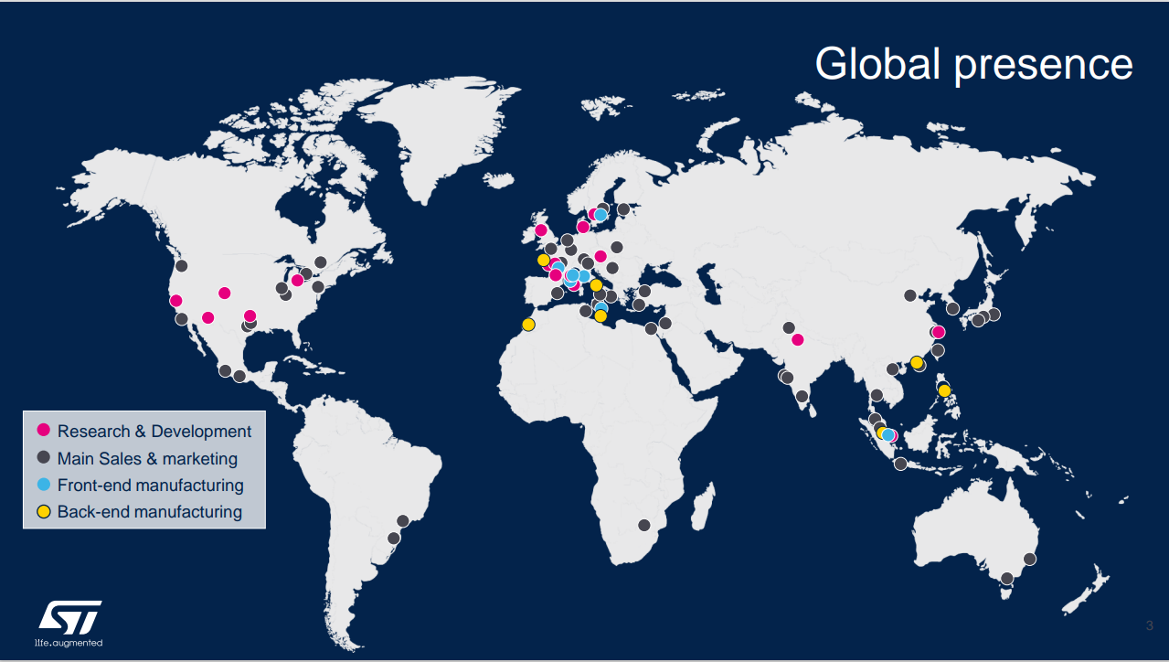
WHAT IS STM?
BACK
NEXT

Slide 6
T1 - Introduction to LSP
This training provides an introduction to Linux system programming, covering the history of Linux, some basic commands, system calls, processes, I/O redirection, environment variables and basics of Linux file systems.
It takes totally 10 sessions with 50 Hours and a final project.
BACK
NEXT

Slide 7
T1 - Introduction to LSP
TABLE OF CONTENTS
Linux History
System Calls
The exec Family of System Calls
Forking Processes
I/O Redirection in Linux
Environment Variables
File Systems Introduction
BACK
NEXT

Slide 8
T1 - Introduction to LSP
TABLE OF CONTENTS
Linux History
System Calls
The exec Family of System Calls
Forking Processes
I/O Redirection in Linux
Environment Variables
File Systems Introduction
BACK
NEXT

Slide 9
T1 - Introduction to LSP
TABLE OF CONTENTS
Linux History
System Calls
The exec Family of System Calls
Forking Processes
I/O Redirection in Linux
Environment Variables
File Systems Introduction
BACK
NEXT

Slide 10
T1 - Introduction to LSP
TABLE OF CONTENTS
Linux History
System Calls
The exec Family of System Calls
Forking Processes
I/O Redirection in Linux
Environment Variables
File Systems Introduction
BACK
NEXT

Slide 11
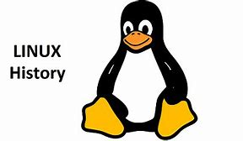
T1 - Introduction to LSP
LINUX HISTORY
The first UNIX operating system was developed in 1969 by Ken Thompson at AT&T’s Bell Laboratories.
In 1970, UNIX was rewritten for the PDP-11 mini-computer.
In 1984, Richard Stallman initiated the GNU Project to create a 'free' UNIX-like operating system.
In 1991, Linus Torvalds released the first version of the Linux kernel.
BACK
NEXT

Slide 12
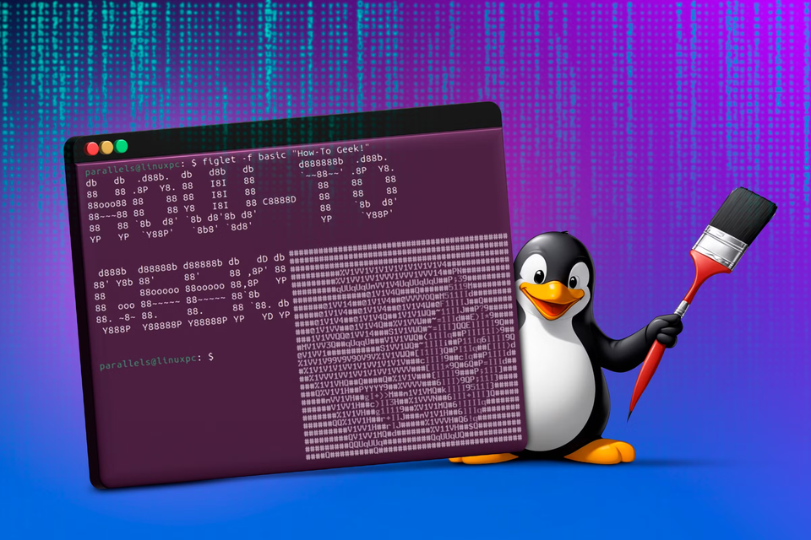
T1 - Introduction to LSP
LINUX TERMINAL
Then we started getting our hands dirty with the linux structure and the terminal by learning some commands.
BACK
NEXT

Slide 13
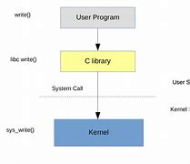
T1 - Introduction to LSP
SYSTEM CALLS
System calls provide the interface between user applications and the kernel.
Common system calls include open, read, write, and close for file management.
Example: open() is used to open a file or device for reading or writing.
BACK
NEXT

Slide 14
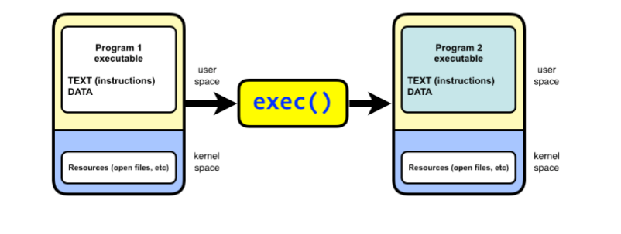
T1 - Introduction to LSP
PROCESS CREATION - EXEC
Exec family allows a running process to replace its own image with a new program.
Commonly used calls: execv and execvp.
Exec calls help in running new programs while passing arguments and handling file descriptors.
BACK
NEXT

Slide 15
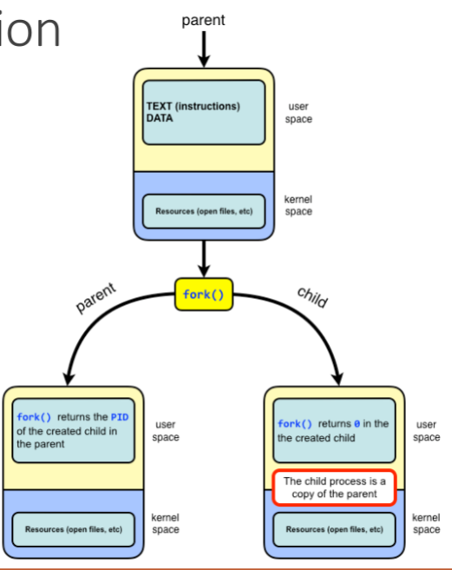
T1 - Introduction to LSP
PROCESS CREATION - FORK
fork() is used to create a new process by duplicating the calling process.
The new process is called the child process.
The parent process can manage the child process using wait() and waitpid().
BACK
NEXT

Slide 16
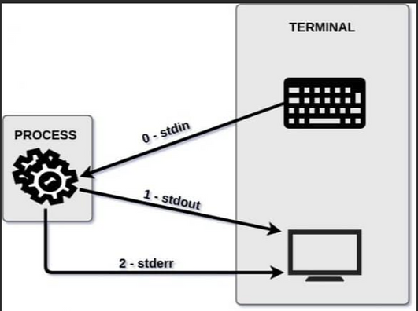
T1 - Introduction to LSP
I/O REDIRECTION IN LINUX
I/O redirection allows the input and output of commands to be redirected.
Types of redirection include standard output (>), standard input (<), and standard error (2>).
Example: echo 'Hello' > file.txt redirects output to a file.
BACK
NEXT

Slide 17
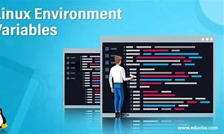
T1 - Introduction to LSP
ENVIRONMENT VARIABLES
Environment variables store configuration settings for the system and processes.
$PATH specifies directories where executable programs are located.
To set an environment variable, use: export VARIABLE_NAME='value'.
BACK
NEXT

Slide 18
T1 - Introduction to LSP
PROJECT - EZZAT SHELL
implement a basic shell that allows users to execute commands. It handles both built-in commands (like echo, pwd, and cd) and external commands (using execvp). The shell creates a new process for each command entered by the user, using fork, and the parent process waits for the child to finish before continuing. It provides an interactive prompt, processes the user's input, and allows for command execution in a loop until the user types exit.
BACK
NEXT

Slide 19
THANK YOU
by Mohamed Ezzat

